Slide 1


The Battle of Two Cultures Statistics Versus (?) Data Science Stochastic Models Versus (?) Algorithmic Models
Bhramar Mukherjee
@BhramarBiostat
bhramar@umich.edu
Lecture Zero, Module 1,
Workshop on Computational Biostatistics and Survival Analysis

Slide 2
Big Data
Datasets with large n (#of records) or large p (#of variables/predictors)
Messy, heterogeneous
Hard to visualize
Classical statistical intuitions often fail

Slide 3
3 Vs, 4 Vs, 7 Vs, 10 Vs and…

Slide 5
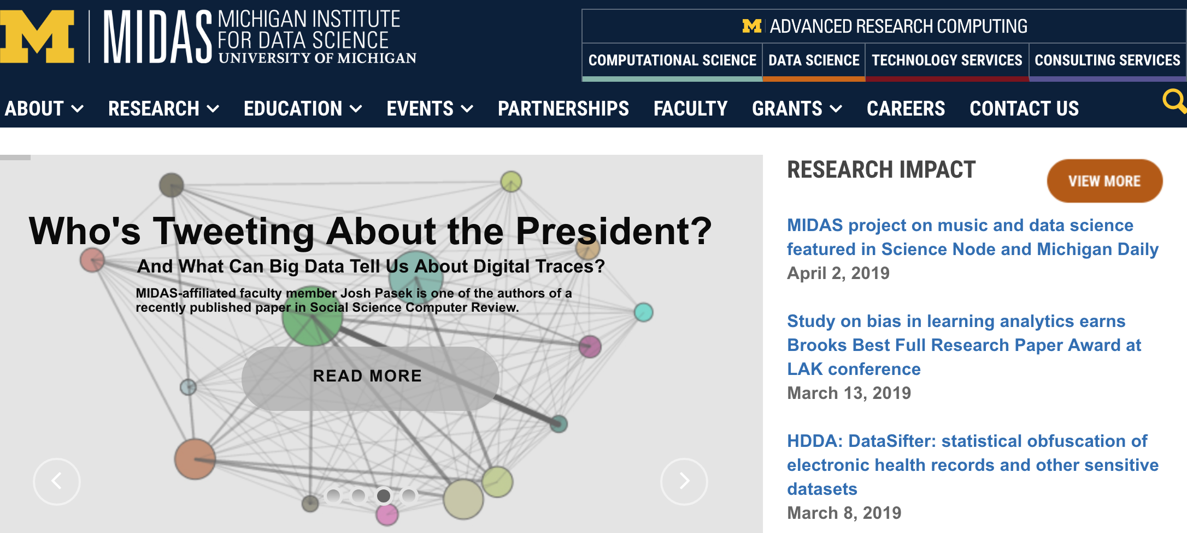
Data Science Initiatives across Universities

Slide 6
New Journals Coming Out
Quote: Xiao-Li Meng,
Editor-in-chief
Harvard University

Slide 7
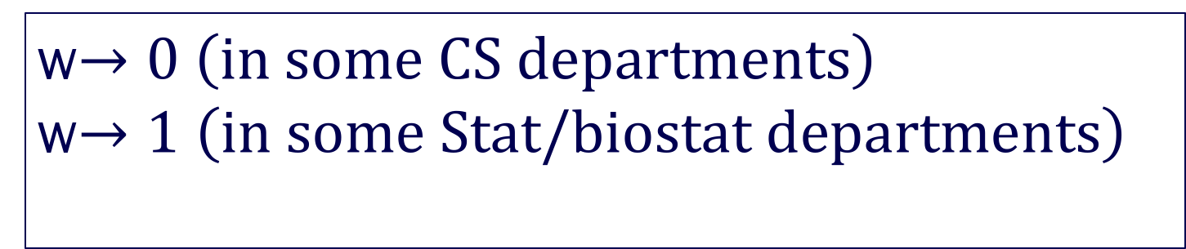
A shrinkage framework for data science
I attempted to define data science as:
w Statistics + (1-w) Computer Science= Data Science
w$→0 \left(in some CS departments\right)$
w$→1$ $\left(in some Stat/biostat departments\right)$

Slide 8
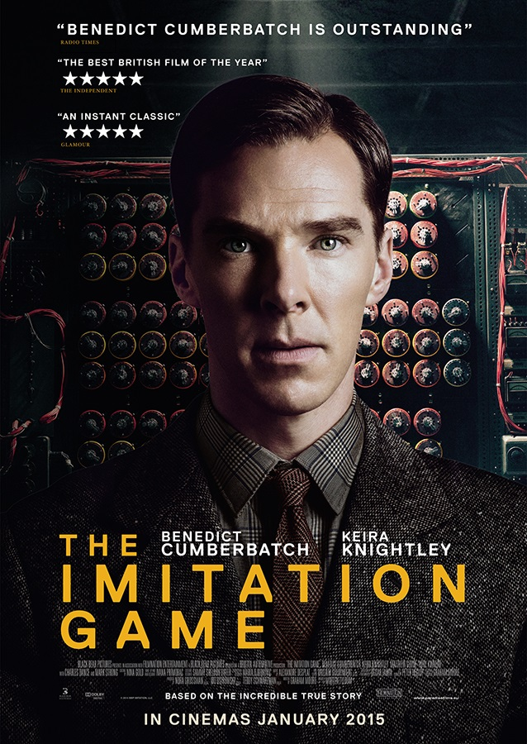
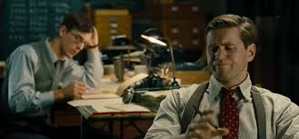
A Race Against Time: The Big Data Prize
“Jack Good appears as a minor and quiet
character in The Imitation Game, which
profoundly misrepresents his contribution
and his character.”-David Banks, 2015
Doer or Thinker? The Identity Crisis of a Statistician!
Notes:
Alan Turing and Jack Good were mathematicians who worked at Bletchley Park in World War II
They developed statistical methods that played a major role in code-breaking German naval ciphers in World War II, arguably reducing the length of WWII by two years or more, saving millions of lives (Turing is the main subject of the 2015 movie, The Imitation Game
His assistant IJ Good became a highly influential figure in the Bayesian revival, was portrayed very quietly in this movie.

Slide 9
It is hard work and statisticians are often poor at marketing!
University of Michigan Rogel Cancer Center
Cancer Control and Population Sciences Annual Retreat, 2019

Slide 10
Big data: precise (massive n) but potentially inaccurate?
Suppose a true target proportion is T=0.4
Small well-designed study:
Estimate = 0.4, Confidence Interval = (0.1, 0.7) [-----T-----]
- low precision, low accuracy, (but no evidence of bias)
Big non-probabilistic sample:
Estimate = 0.5, Confidence Interval (0.47, 0.53) T [---]
- high precision, low accuracy (biased)
Desirable property:
Estimate = 0.42, Confidence Interval = (0.39, 0.45) [-T-]
- high precision, high accuracy (no evidence of bias)

Slide 11
Inspired by a timeless paper

Slide 12

Leo Breiman
Born in NYC 1928
Undergrad from Cal Tech (Physics)
MS (Columbia, Math)
PhD (UC Berkeley, Math)
Faculty at UCLA, Berkeley
Independent consultant for 13 years
Theory of Gambling, CART, Bagging, Alternating Conditional Expectation
Passed away in 2005
Notes:
In his interview with Richard Olshen he says he went to a high school full of highly motivated sons and daughters of immigrants. He went to caltech because his mother thought her son should go to the best science school in the West.
Caltech felt like scientific monastery to him as there was nothing but science and engineering and Leo was a true polymath. Got 4 D’s in his final year.
Went to Columbia to do philosophy but the chair said philosophers cannot get jobs so stick with math! Took classes in Aesthetics and Greek Philosophy
Worked with famous probabilist Michel Loeve for thesis. Strong influence of Cramer, Blackwell, Neyman. After PhD started a business in Mexico selling purified ice…
Got a job in UCLA, got tenured, quit it to write his first book.
Took sabbatical as a educational statistician from UNESCO in Liberia. “Little children will walk up to me to see if the white would rub off”...Resigned from UCLA, took out his retirement funds and spent it. Became an ind consultant for EPA.

Slide 13
The Activist
Campaign Flyer for
Santa Monica School Board
Leo Breiman with school children in Mexico
Notes:
Teaching kids, nurturing kids, helping kids was a big part of his life.

Slide 14
The Artist

Slide 15
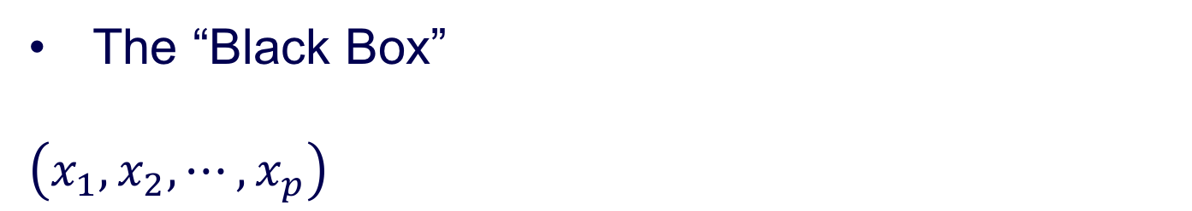
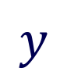
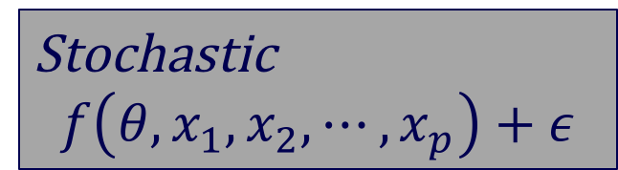
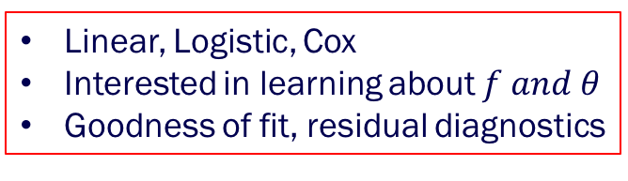
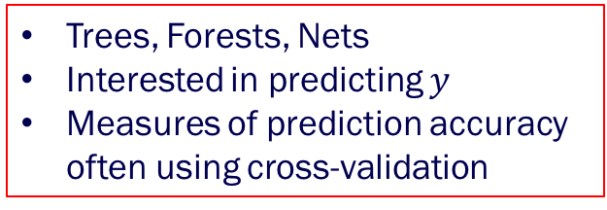
Fundamentals of Data Models
The “Black Box”
$\left(x_{1},x_{2},⋯,x_{p}\right)$
Nature
$$y$$
Nature
Stochastic
$$f\left({θ, x}_{1},x_{2},⋯, x_{p}\right)+ε$$
Algorithmic
?????????
Trees, Forests, Nets
Interested in predicting $y$
Measures of prediction accuracy
often using cross-validation
Linear, Logistic, Cox
Interested in learning about $f and θ$
Goodness of fit, residual diagnostics

Slide 16
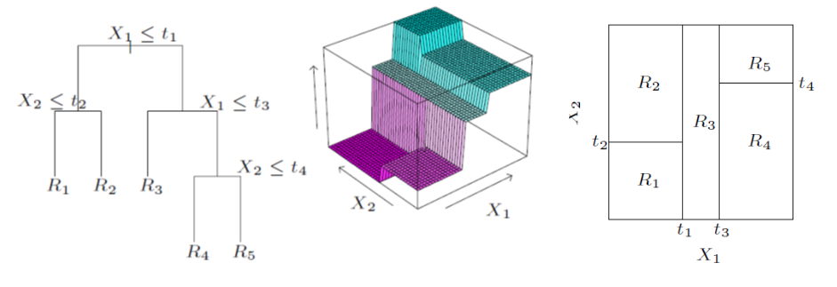
Decision Trees
The Elements of Statistical Learning: Data Mining, Inference, and Prediction, Hastie, Tibshirani and Friedman. Second Edition, 2009.

Slide 17
Random Forest
•A collection of bagged decision trees.
•Randomly select m predictors at each split when building the tree.
•Decorrelates the trees when bagging, which further reduces the variance.

Slide 18
What troubled Breiman about data models
“Assume the data are generated by the following model….”
The conclusions from inference regarding the parameters are about the model’s mechanism, not about nature’s mechanism
If the model is a poor emulation of nature, the conclusions may be wrong.
“Statisticians like all artists have the bad habit of falling in love with their models.”-George EP Box

Slide 19
Model Validation
Goodness of fit tests lack power
Residual analysis fails in high dimensions to uncover lack of fit
A set of rival models: all equally good in representing one true state of nature?
Less emphasis on cross-validation, out of sample prediction accuracy

Slide 20
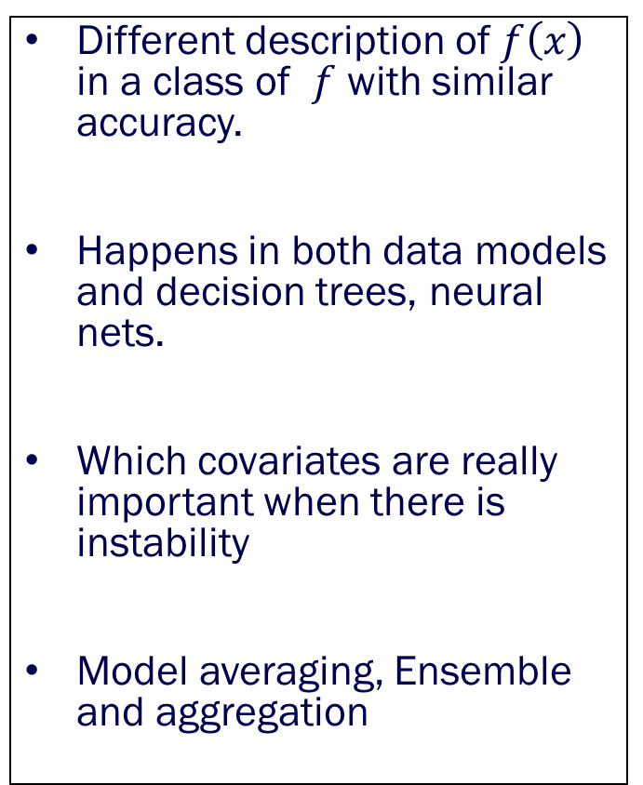
Rashomon versus Occam
Rashomon
Occam
Different description of $f\left(x\right)$ in a class of $f$ with similar accuracy.
Happens in both data models and decision trees, neural nets.
Which covariates are really important when there is instability
Model averaging, Ensemble and aggregation
Simpler is better
Conflict between accuracy and simplicity
Trees are interpretable but not good as predictors
Random Forests are superior predictors but hard to interpret
Notes:
Trevor Hastie said RF are good benchmark of what you can do.

Slide 21
How to solve this dilemma?
Curse of dimensionality: Richard Bellman
Feature extraction for dimension reduction
Can dimensionality be a blessing for PREDICTION?
Shall we throw in millions of markers in a GWAS study?
Can we forget about testing, estimation, identification of important variables and just run the world by prediction?

Slide 22
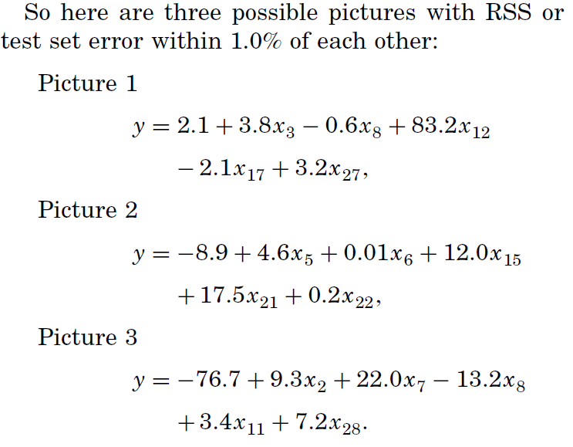
Rashomon: the multiplicity of good models
Leo Breiman (2001) Statistical Modeling: The Two Cultures, Statistical Science, 16 (3), 199-231.

Slide 23
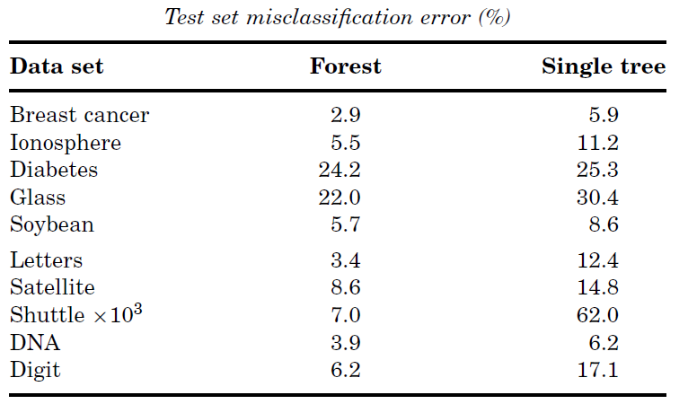
Occam: simplicity vs. accuracy
Leo Breiman (2001) Statistical Modeling: The Two Cultures, Statistical Science, 16 (3), 199-231.

Slide 24
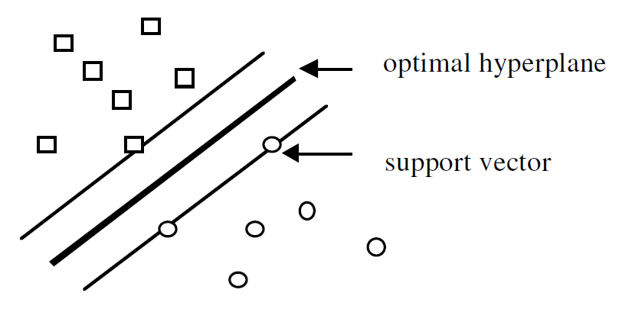
Bellman: dimensionality — curse or blessing
Leo Breiman (2001) Statistical Modeling: The Two Cultures, Statistical Science, 16 (3), 199-231.

Slide 25
Two Black Boxes
Both inscrutable, complex
Simple linear models cannot capture the complexity and misrepresent what are important variables by ignoring non-linearity, interactions
Higher Predictive accuracy is a signature of reliable information about underlying data mechanisms
Nature
Fifty trees hooked together

Slide 26
Pros and Cons of ML/AI
Captures complexity
Better prediction
Less structured assumptions
Interpretability
Too many user-defined tuning parameters
Overfitting
Less inference, limited asymptotic theory, less characterization of uncertainty
Computationally challenging, convergence issues

Slide 27
There is life and science beyond prediction
Testing, Estimation, Characterizing Uncertainty
Sampling, Sampling Sampling: Who is in the study?
Which population is my target of inference?
Basic principles of Experimental Design
Principled data integration
Missing data
Causality
Incorporating clinical/scientific context into the problem

Slide 28
Life (as a quantitative scientist) is Spectacular!
Leo Breiman’s ID for serving as a dishwasher in the Marine
Notes:
I resonate with Breiman’s strong pitch that in order to serve as energetic and creative field we need to be flexible, responsive, value impact.

Slide 29
A Dramatic Digression
A conversation is about to take place between a Dr. Dea X. Machina, a well-known machine learner with a PhD in computational statistics from Stanford, and a classical statistician with an ancient PhD from Imperial College, London….

Slide 30
Quote from a recent paper
“Seeing scientific application turn into methodological advances is always a joy, at least for those of us who care about the science of data, in addition to advancing science with data”
-``Conducting Highly Principled Data Science: A Statistician’s Job and Joy ‘’
by Xiao-Li Meng, Harvard University

Slide 31
Models or Trees? Choose your own answer!
Notes:
May be there is a place for both.

Slide 32
Gartners Hype Cycle
Notes:
AI, Augmented analytics, blockchain, quantum computing

Slide 33
Forget the buzz word, do cool science without boundaries

Slide 34
New New Explorers of New Horizonsof New Horizons
The University of Michigan Big Data Summer Institute

Slide 35
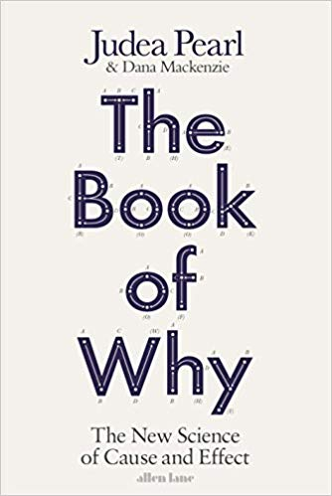
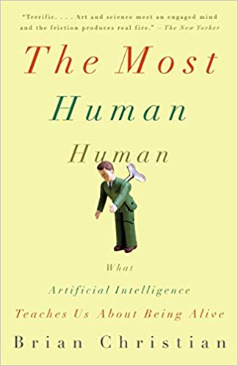
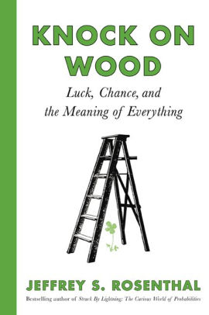
The union of many cultures is always the best! Let us call that data science.
Collaborate: not compete!
Notes:
It is a pleasure to converse with you about data, science and data science for the next 12 minutes. We all are breathing and living at a time where understanding the science of data is becoming increasingly important before doing any science with data..

